Slide 1


Medium Article Recommadation
sbert_model was used to implement
STAT 5870 - Big Data Analysis Using Python
895161024 - Benakana Harikrishna Reddy

Slide 2

Agenda
Overview
Articles.csv
content.csv
Model Intro - sbert
Model Architecture - sbert
STAT 5870

Slide 3
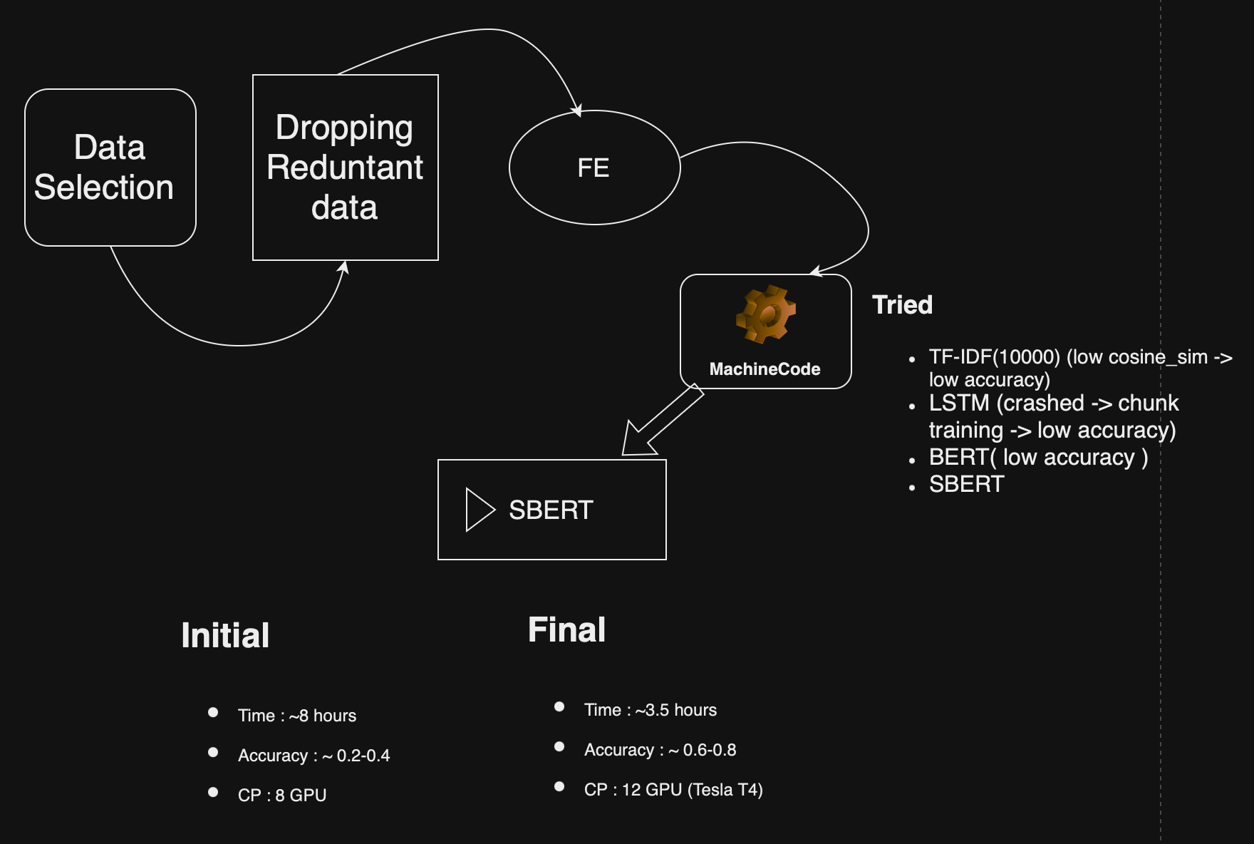
Overview
Data flow/Manipulation/Building
STAT 5870

Slide 4
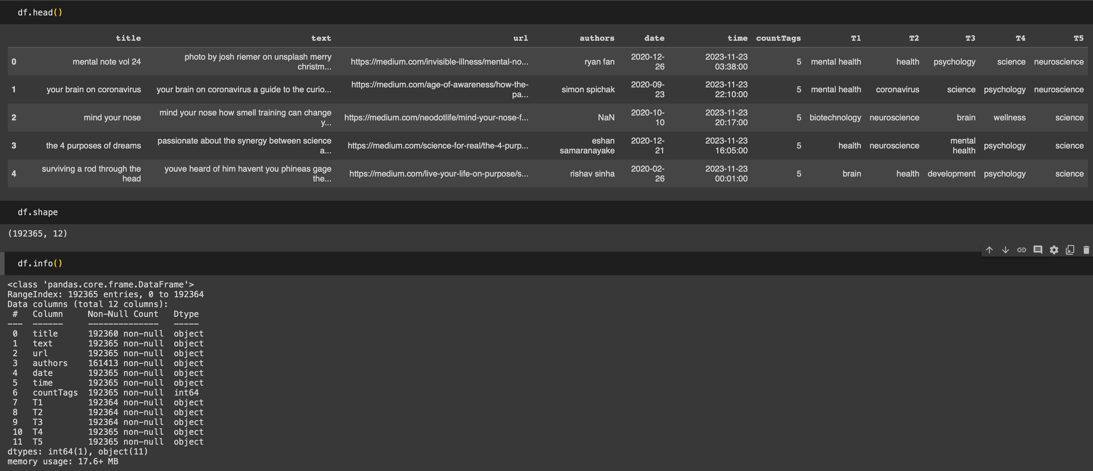
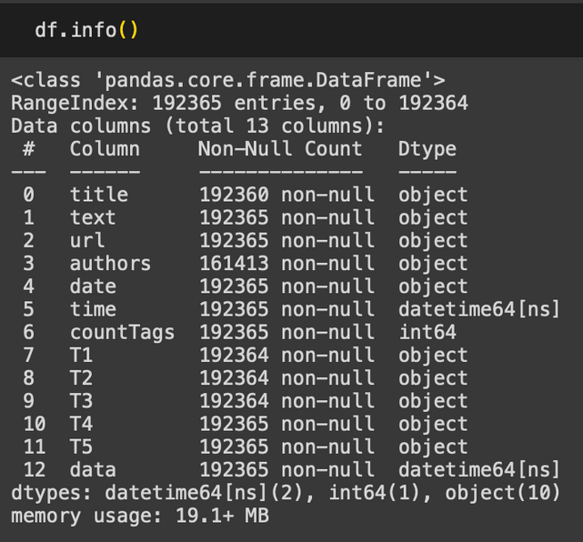
Little info on Data

Slide 5
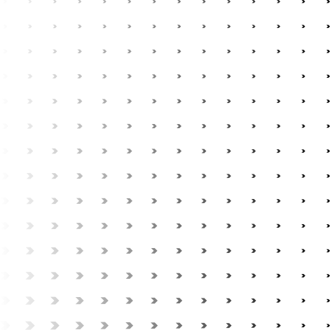
Articles.csv
Dropped null values
typecasting and FE of ‘timestamp’
Data Cleaning on ‘title’,’author’ & ‘text’
Removing invalid values/charachter
lowering the case
Ananlysis
Articles with more than one author
Articles with Multiple Authors: 161373
Average tags per articles
Average Tags per Article: 4.577690444257301
distribution of articles over time
2020 115846
2021 32182
2019 26221
2018 9846
Visualization
Top 10 most popular/used tags
Distribution & Trend of Article Publications Over Years
Year-wise Distribution of Articles (Box-and-Whisker Plot)
Divided tags feature into T1,T2,T3,T4 & T5 after preprcessing
STAT 5870

Slide 6
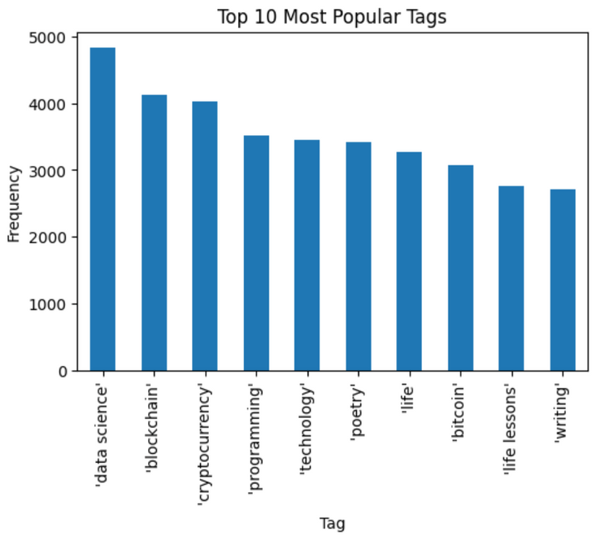
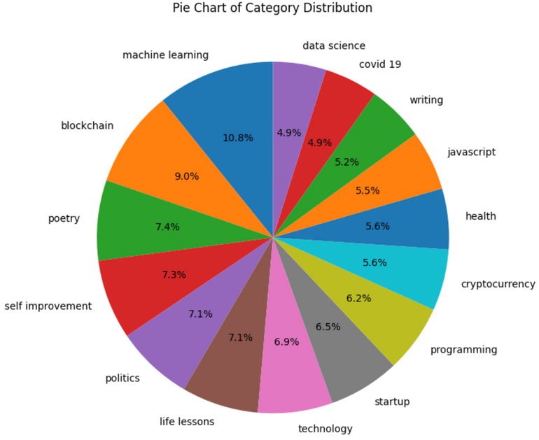
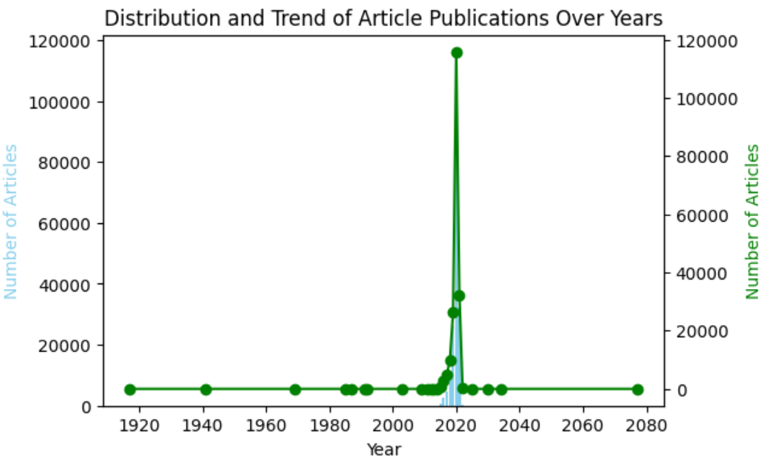
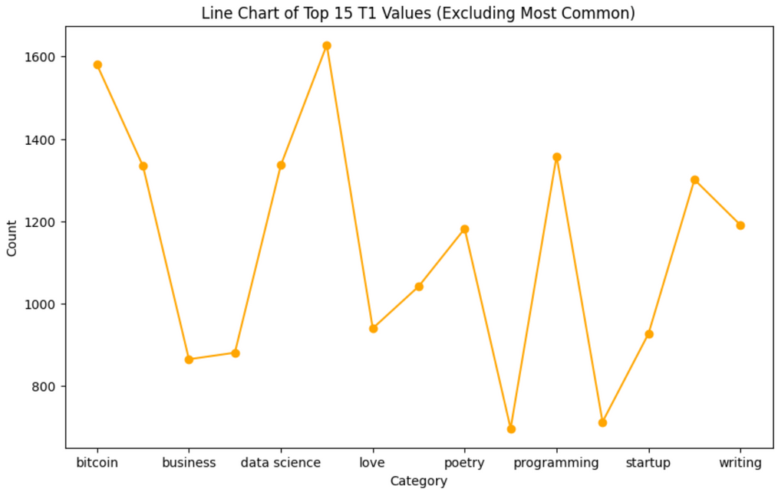
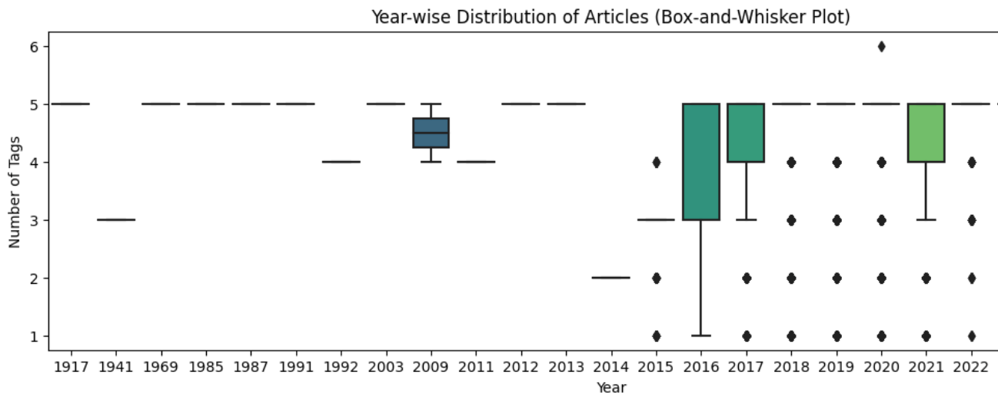

Slide 7
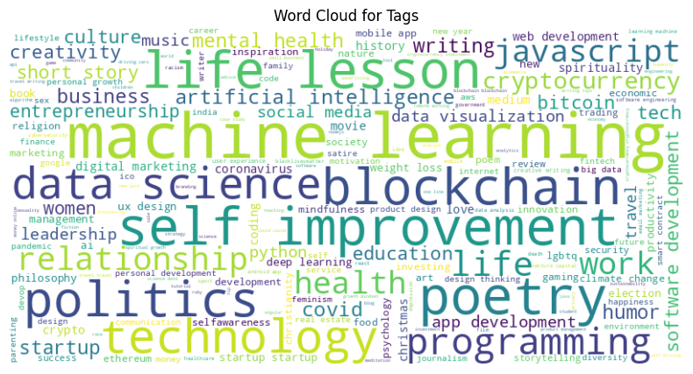
(conti.)
STAT 5870

Slide 8
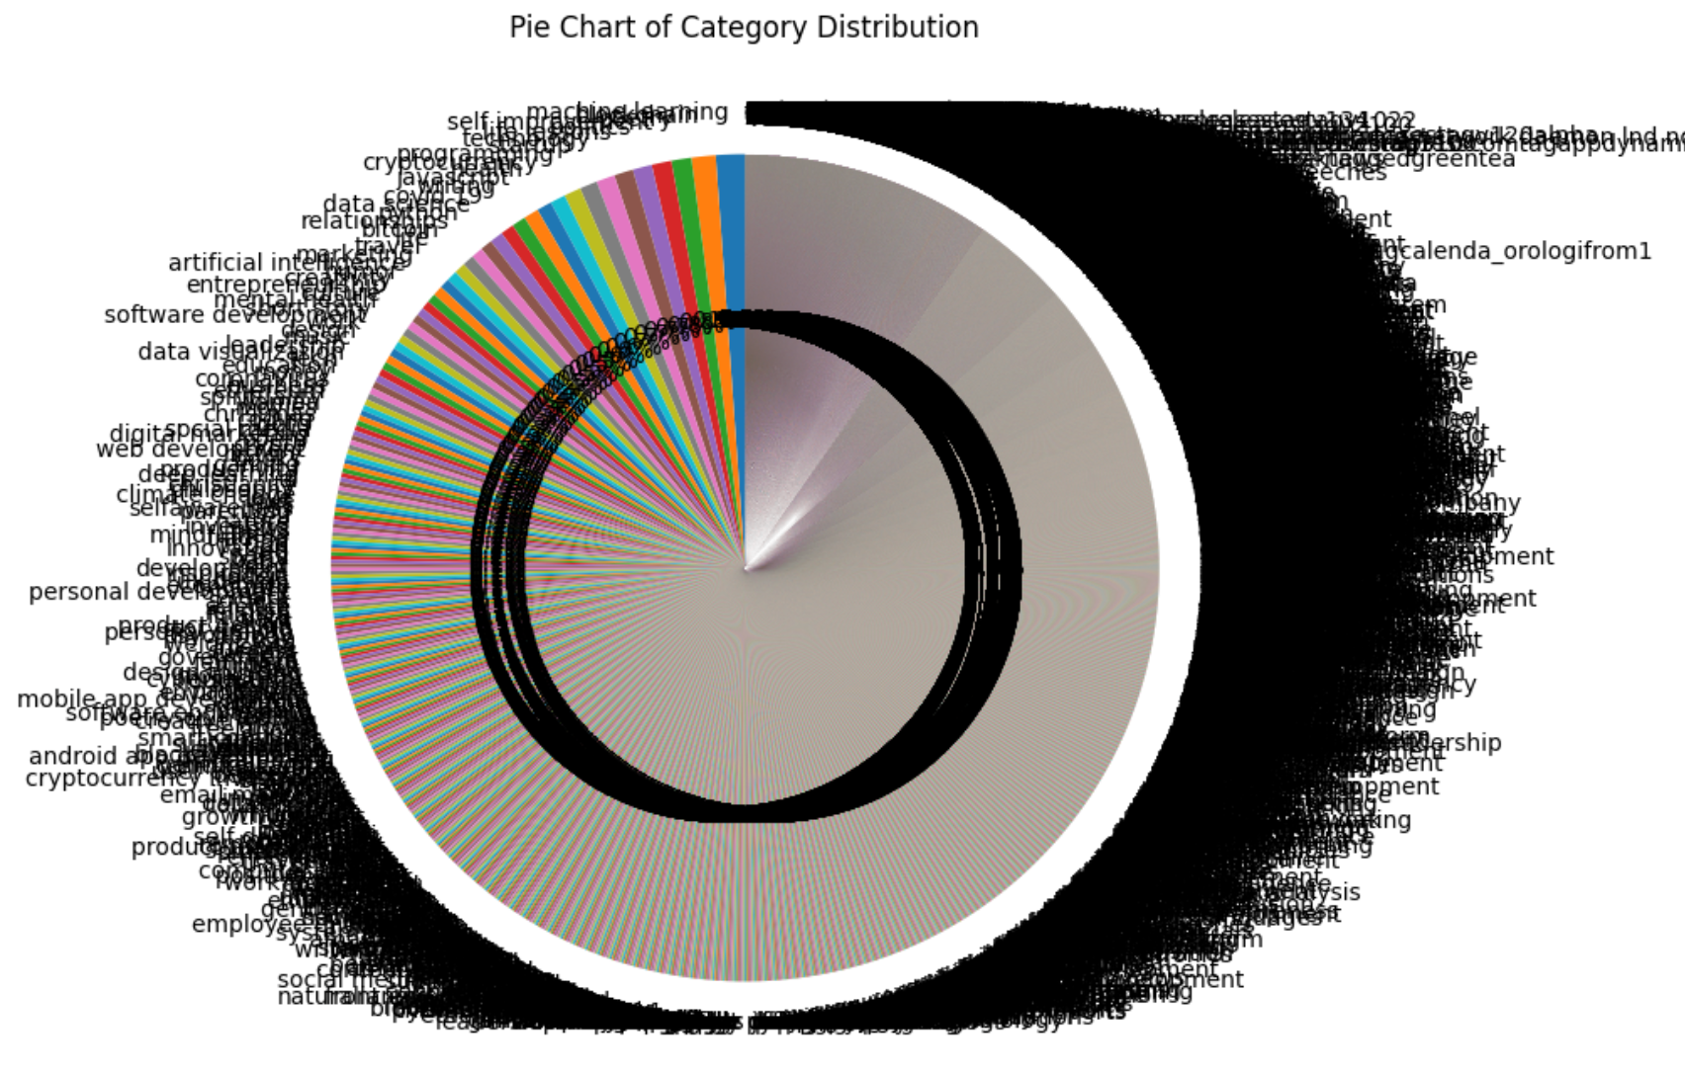
Never visualize too much

Slide 9

Text Preprocessing
Feature Engineering
Machine Code
generated tokens and validated
removed stop words
Combined title and tags to generate the TF-IDF vector and matrix to build model, but due to large data cosine_sim between text was too low and we moved to sbert
By removing the all the reduntant features we created content.csv for efficient processing
Used 1 GPU: Tesla T4 to convert text to machine readable and build the train the modle with sbert
SentenceTransformer('bert-base-nli-mean-tokens') is used to preprocess the data and before create embeddings of the text data
Created embeddings by using the inbuilt funtion in sbert i.e sbert_model.encode()
STAT 5870

Slide 10
Model Intro- sbert
SentenceTransformer('bert-base-nli-mean-tokens') SentenceTransformer('bert-base-nli-mean-tokens') is a pretrained sentence transformer model from the sentence-transformers library. It is based on the BERT (Bidirectional Encoder Representations from Transformers) architecture, which is a powerful neural network architecture for natural language processing (NLP) tasks. The 'bert-base-nli-mean-tokens' model specifically uses a mean pooling layer to combine the contextualized word embeddings produced by the BERT encoder. Key Charaecteristics State of art model It is based on the BERT architecture Uses a mean pooling layer
STAT 5870

Slide 11
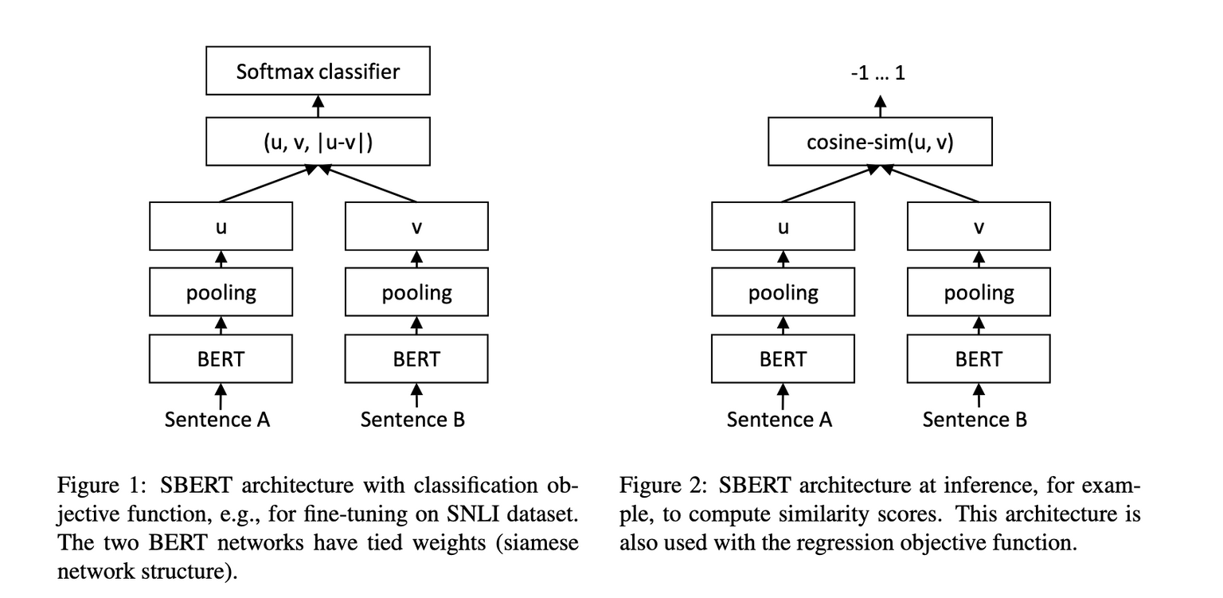
Inspired from BERT & RoBERTa In this sbert, a modification to bert siamese and triplet network structure to give siementical meaning sentence When compared sbert with BERT or RoBERTa or other state-of-art models it was performing better than them ! In sbert, siamese network enables vectors for input sentences can be delivered. Using a similarity measure like cosine-similarity or Manhatten / Euclidean distance, semantically similar sentences can be found. After Fine-tuning sbert on NLI data, it out performed the state of art models.
Architecture

Slide 12
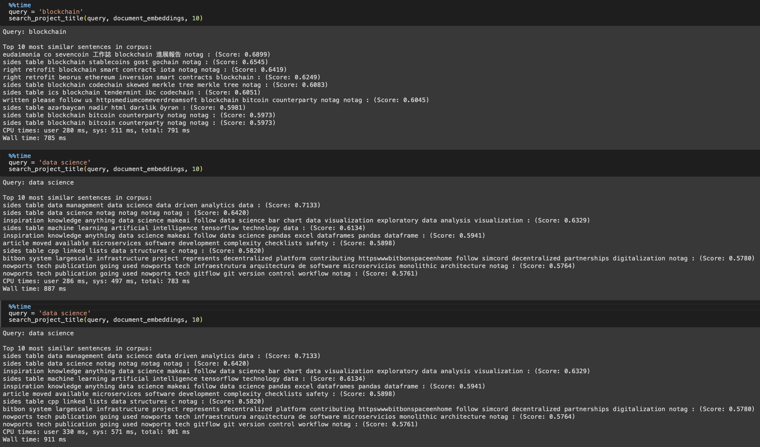
ResulTS

Slide 13
Future work/thoughts
It will be a webpage extenstion or any app which can read a file(s) of given loction.
We will scrap and preprocess the data(webpage) and train the model.
Where the extentsion can give you the summary or answer any question within the information of the webpage.
if we can use G-API(not for free though), we can also suggest the websites based on pagerank similarity
COMING SOON

Slide 14


STAT 5870
In the quiet hum of algorithms, time unfolds its coded grace, As each epoch whispers secrets, in the dance of ones and zeros, we embrace.
If you have any queries you can reach me out at linkedin.com/in/bharikrishnareddy/

